Slide 1
Introduction to R and R Studio
Session 1
Joseph Rudolf
July 16, 2020

Slide 2
July 16 2020 | Session | Instructor
1:00 pm - 1:30 pm | Instructor Introductions, Introduction to technology | Amrom Obstfeld
1:30 pm - 2:15 pm | Introduction to R and RStudio | Joe Rudolf
2:30 pm - 3:15 pm | Reproducible Reporting | Patrick Mathias
3:30 pm - 5:00 pm | Data Visualization | Stephan Kadauke
July 17 2020
1:00 pm - 2:30 pm | Data Transformation | Amrom Obstfeld
2:45 pm - 4:15 pm | Statistical Analysis | Dan Herman
4:30 pm - 5:00 pm | Advanced Reporting | Patrick Mathias

Slide 3
Lesson Goals
Get oriented to R and RStudio
Learn some fundamentals of coding
Lesson Objectives
Log in and tour RStudio Cloud
Execute code at the console
Define and use functions
Define and create objects in the environment
Load data into R and interact with a dataframe
Notes:
In this first session our goal is to develop some familiarity with the R programming language as well as some basic proficiency with coding fundamentals as they are implemented in R.
We will log into the R environment and learn about the how to execute code in the console.
Upon this we will layer concepts of functions and objects. We will use some basic functions and make some objects.
Finally we will load data and interact with a dataframe.

Slide 4
Getting Oriented to R

Slide 5
What is R?
R is a statistical programming language.
Using R you can load, analyze, and visualize data.
R also provides an environment in which we can conduct reproducible data analysis.
Documented
Revisable
Shareable
Notes:
R is a statistical programming language. It is freely available and has been evolving for > 25 years.
R is popular with statisticians and data analysts. It’s flexible, extensible, and broadly capable for the import, analysis, and visualization data.
R supports everything from linear regression to machine learning.
R also enables us to conduct reproducible analysis that we can document, iterate, and share with colleagues. R is great for those looking to graduate from working with spreadsheets.

Slide 6
RStudio: The Portal to R
RStudio is an integrated development environment (IDE)
Using RStudio we can interact with the R programming language to:
Write and execute code interactively
View data
Debug and fix errors
Author our code
Notes:
A base install of R gives us the ability to write and execute code.
However, many R users choose to leverage an integrated development environment (IDE) for their work in addition to the base install. An IDE layers over the R programming language and provides a more streamlined way for us to work with R.
The most popular R IDE is RStudio. This is the IDE we will be using in this course. RStudio is also a company (the that produces the RStudio IDE). In this course, when we say RStudio, we are referring to the IDE software.
RStudio adds many features to the basic R installation including the ability to easily view data, identify syntax (code grammar), and debug our code to fix errors.

Slide 7
RStudio: In the Cloud… In Your Home
RStudio Cloud: An online hosted version of RStudio that we will use for these course sessions
RStudio Desktop: A locally installed version of RStudio that you will use when you get home to continue your learning
Note: Use Rstudio Cloud only for this course. Do not upload protected health information to the cloud!
Notes:
For today’s course we plan to leverage RStudio Cloud. RStudio Cloud is an internet hosted version of RStudio which allowed us to prepare an environment and prepopulate it with data, code, and exercises so you don’t have to spend your energy on those pieces.
When you get home, you will likely transition to using a RStudio Desktop which is a locally installed version of RStudio. We suggested that you install the desktop version ahead of this course so you will be ready to continue to learning R when you walk out of the classroom this afternoon and as a fallback in the event that we experience technical challenges with the cloud deployment.

Slide 8
Your Turn
Navigate to: https://bit.ly/api-r-cloud
Enter your log in credentials
Join Space
Make a copy of the Core Exercises for yourself
Notes:
Let’s take a few minutes to get logged into RStudio Cloud.
In the pre-course email, we asked you to create an RStudio log in. Use those credentials now to access the cloud instance.
The following slides show the clicks to copy the workspace.
When you are finished, click the “yes” button in Zoom. If you get stuck, please use the “raise hand” button in Zoom.

Slide 9
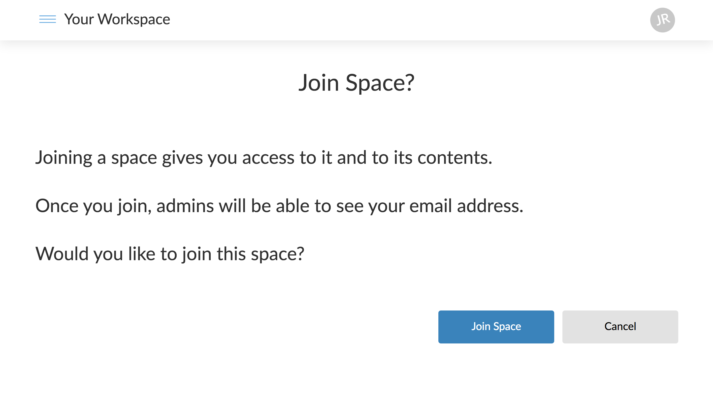
Notes:
Click “Join Space”

Slide 10
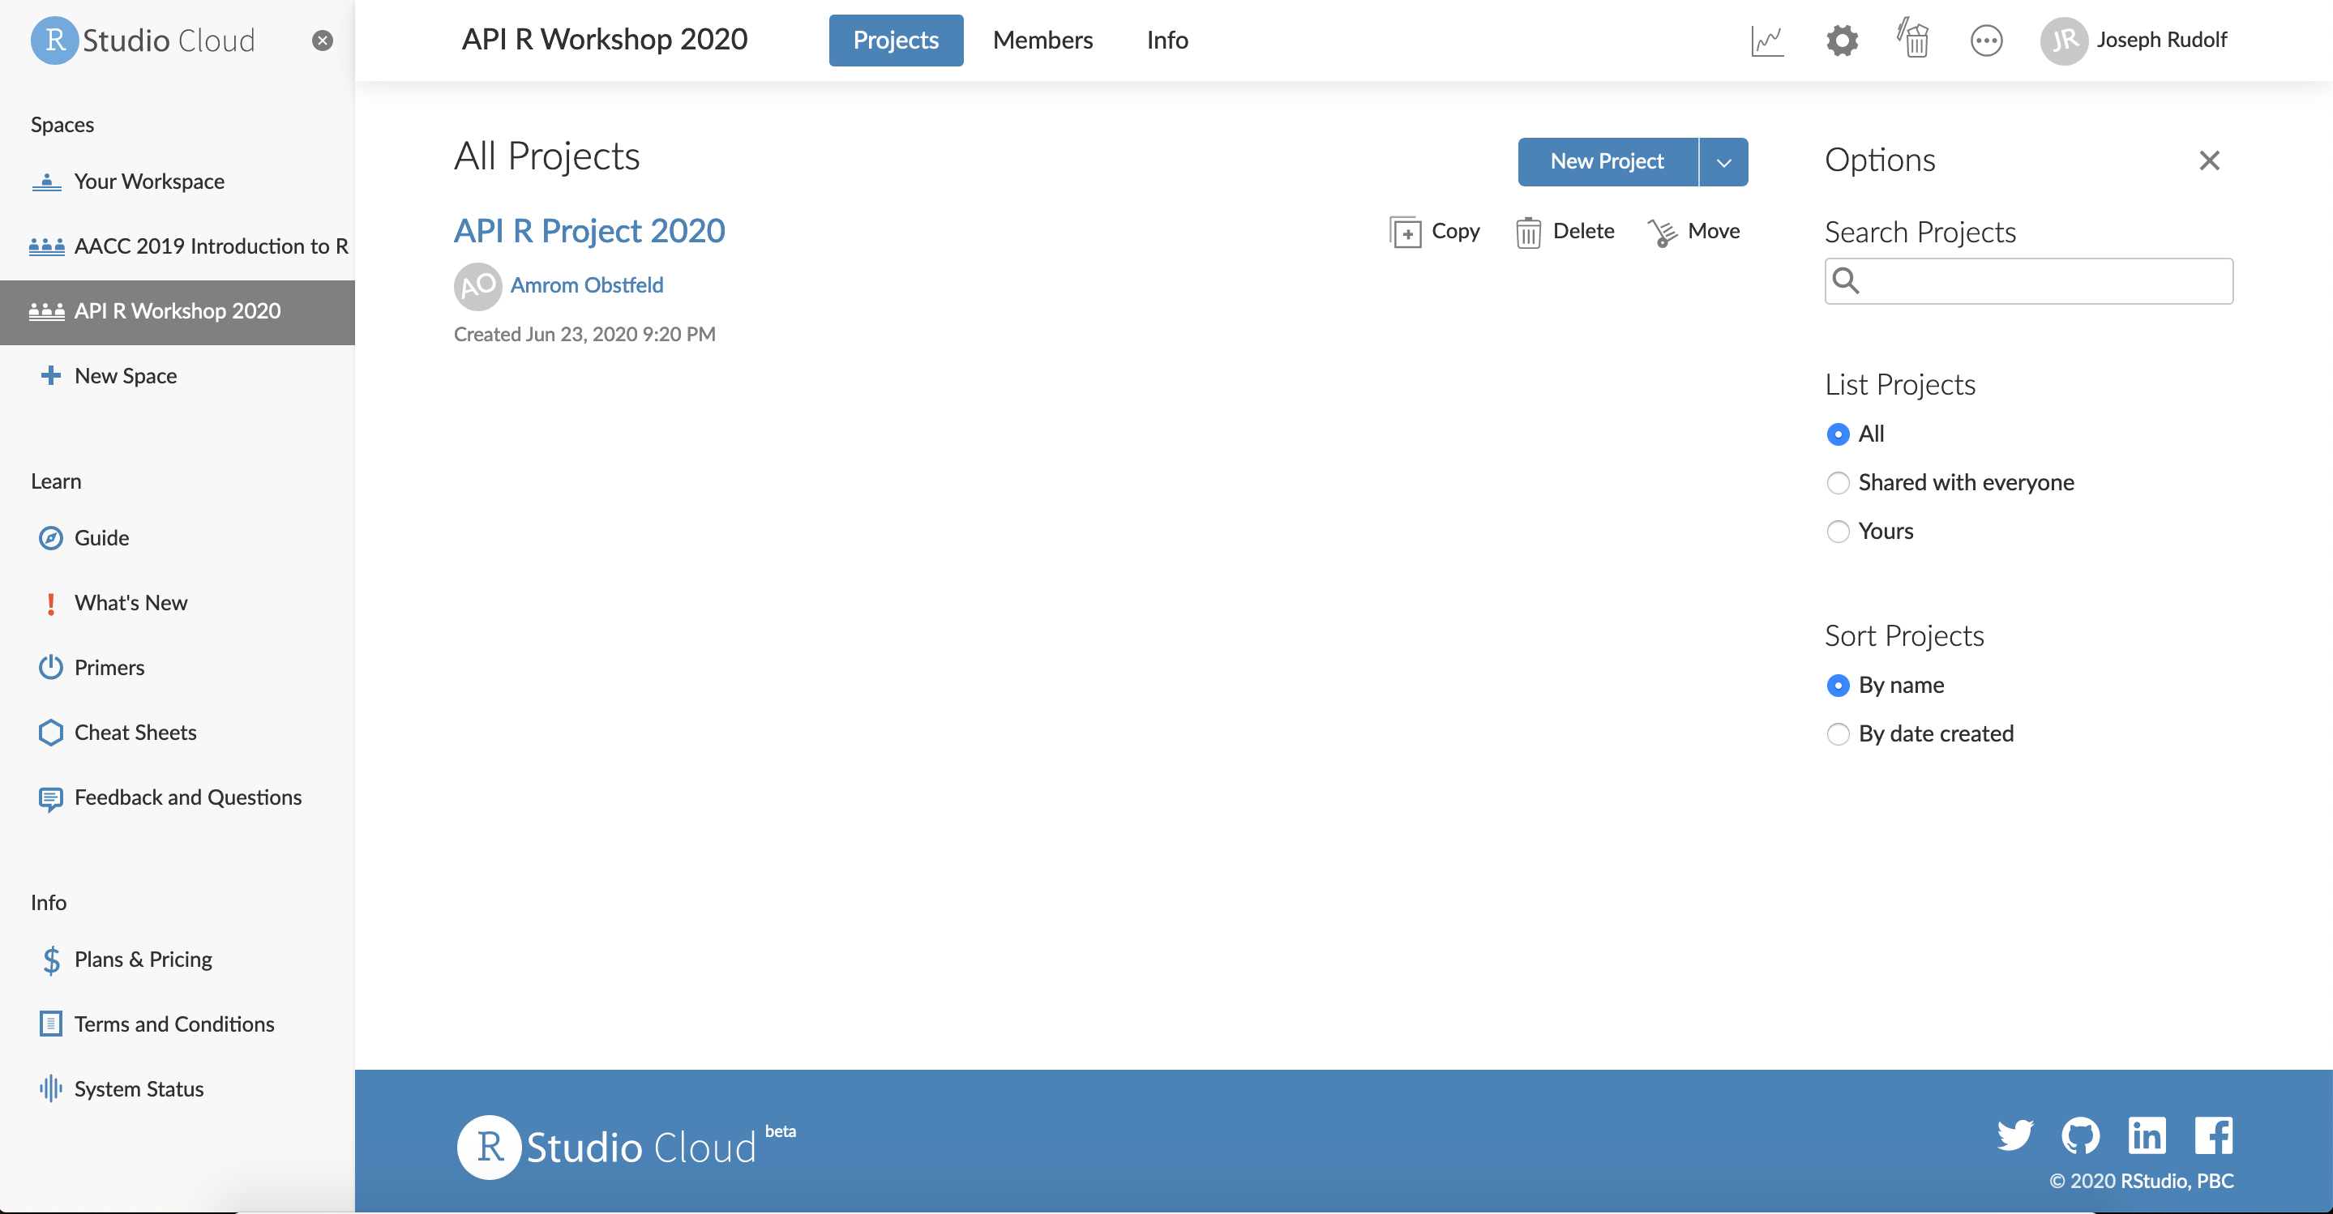
Notes:
Select the workspace “API R Workshop 2020”
Click “Copy” to create your own version of the core course workspace.

Slide 11
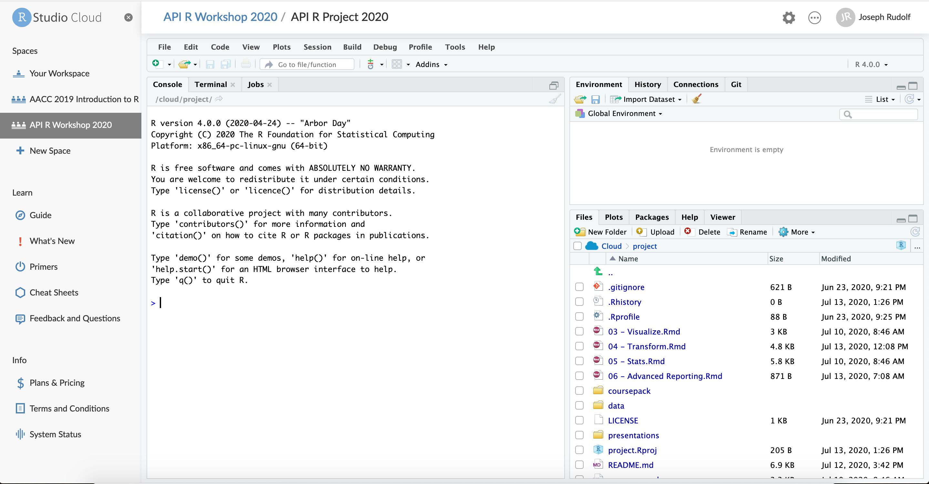
Notes:
Wait for for your version of the project to spin up.
Your screen will look like this when the work space is finished loading.

Slide 12
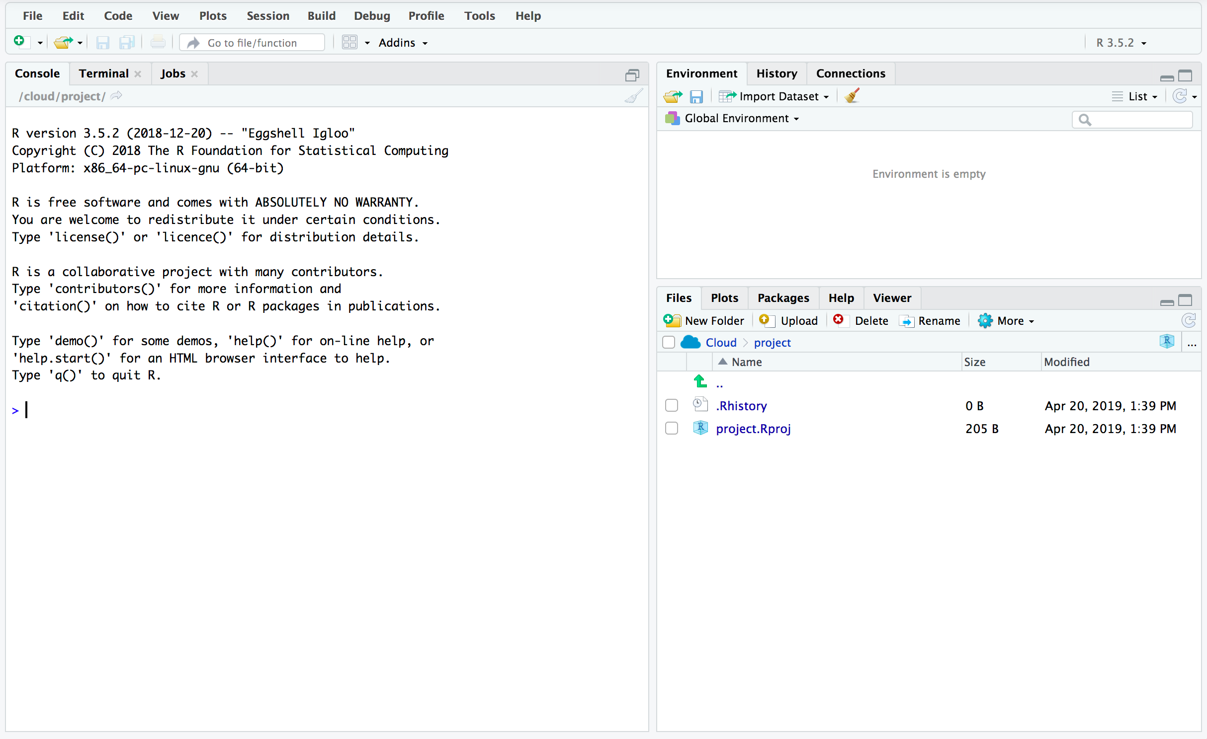
Overview of the RStudio Environment
ENVIRONMENT
CONSOLE
OUTPUT
Notes:
This is the basic RStudio layout.
Console – Where we will enter and execute the code we write in this session.
Environment – Where objects (think variables or containers for storing data) will appear.
Output – Where the output of our visualization occurs. It also has tabs for us to browse file locations and interact with the help documentation

Slide 13
The Basics of Coding

Slide 14
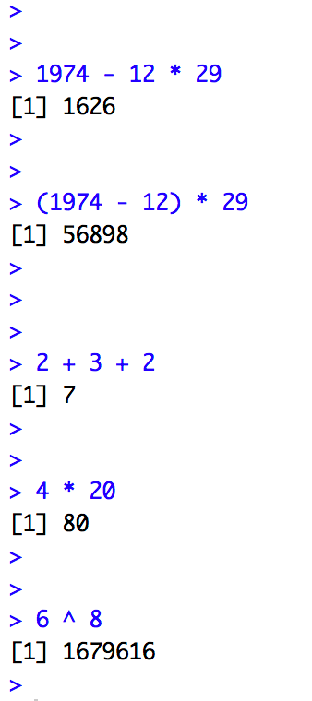
The Basics of Coding: Calculation
R is a calculator!
enter/return to execute code
answer returned here
Notes:
At it’s most basic, R is a fancy calculator.
It supports common mathematical operators
+ add, - subtract
* multiply, / divide
^ exponents
We type our code at the console and use the enter (return) key to execute.
The answer is returned on the following line.

Slide 15
Your Turn 1
Place your cursor at the console and click to enter the console.
Complete the following calculation:
-For the date 12-29-1974
-Take the four digit year
-Subtract the month then multiply by the day
Notes:
Now it’s your turn to do some coding.
Complete the following exercise.

Slide 16
What did you get?
A four digit number? A five digit number?
Order of operations matters!
Notes:
Let’s review our answers.
Order of operations matters
exponents and roots first
multiplication and division
addition and subtraction
Multiplication will occur before subtraction unless we embed our operation in parentheses.

Slide 17
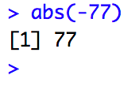
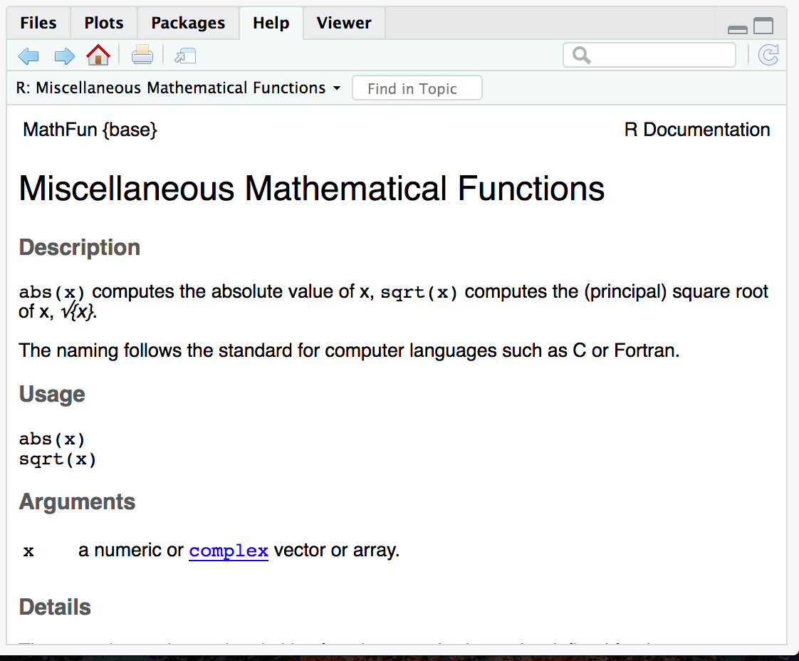
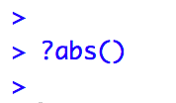
The Basics of Coding: Functions
function
(does stuff)
argument
(input)
Code that extends our reach beyond the basic operators
What if I don’t know what a function does?
abs(-77 )
Notes:
Functions are code that perform actions on our behalf. We can use functions that others have written (or that we write ourselves) to reuse existing code over and over.
Functions accept an argument (input). We use parentheses as the syntax (grammar) to identify the argument(s).
Then the function does its task and provides us with some output, in this case the absolute value of an integer.
The help feature in R is very… helpful! Preceding a function with ? and executing the line will bring up help documentation and will educate us on how to use a function.

Slide 18
When you need more help
The Internet (Stack Overflow: https://stackoverflow.com/)
Work Aids (RStudio Cheat Sheets: https://www.rstudio.com/resources/cheatsheets/)
A Good Book (R for Data Science: http://r4ds.had.co.nz/)
Notes:
Sometimes you will need more help than the R help feature provides.
There are many wonderful freely available resources on the internet to assist you.
Chances are others have tackled similar challenges. A quick internet or forum search can often provide an answer.
The folks at RStudio have developed a number of cheat sheets which are great references. Many of us keep printed copies of these near our desks for the features and tools we use most.
Also, there are a number of great reference books out there. One of our favorites is R for Data Science. It is freely available online and print copies are available also.

Slide 19
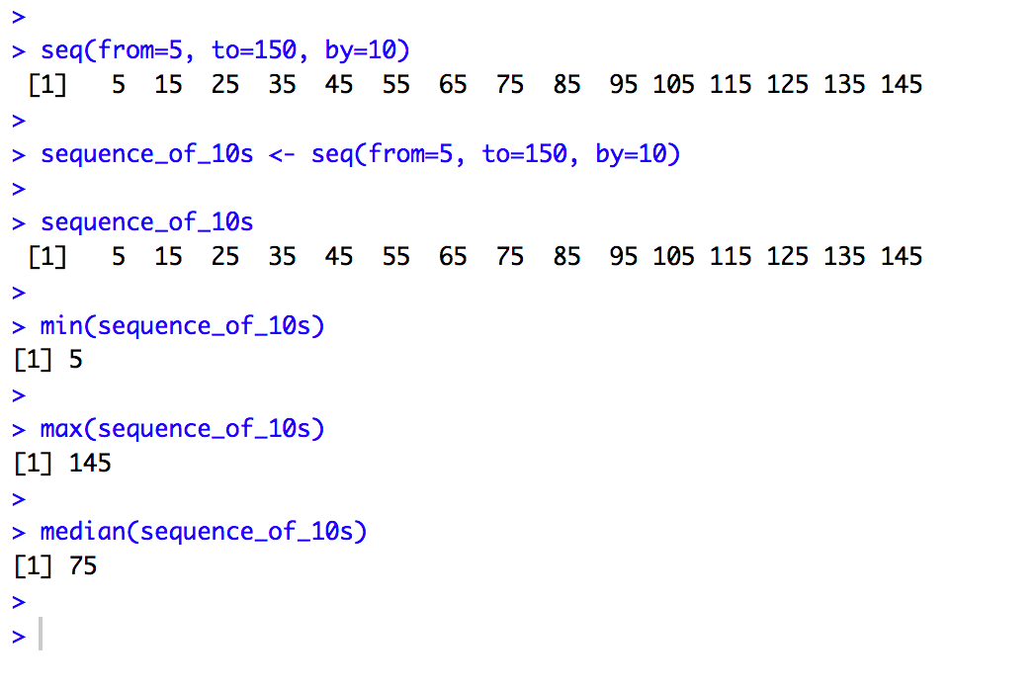
Putting Functions to Work
We can use functions to do more than simple math, we can make things!
We can create a series of integers (a vector) using the seq() function
Notes:
Functions can do more than simple math.
In this case the sequence function seq() accepts arguments defining a start position, a stop position, and an interval, to create a series (a vector) of integers.

Slide 20
The Basics of Coding: Objects
Objects are the container for your output
object
(stores output)
function
(does stuff)
arguments
(input)
sequence_of_10s <- seq(from=5, to=150, by=10 )
Notes:
Objects are a very important concept in many programming language.
Objects are the containers in which we can store things for later use.
You can store single values, series, tables, or even text.
In this example we are taking our previous seq() created series and storing it out to an object which we have called sequence_of_10s.
The <- characters are called an assignment operator. They point to the place where we want to store output.

Slide 21
Checking the Contents of an Object
Entering the object name at the console allows us to output the contents of an object.
Notes:
We can call our object at the console by typing the object name and pressing enter/return.
You can execute code without assigning it to an object however the output is not stored for future use. If you want to revisit or reference the output of a particular line of code, assign it to an object using the assignment operator <-

Slide 22
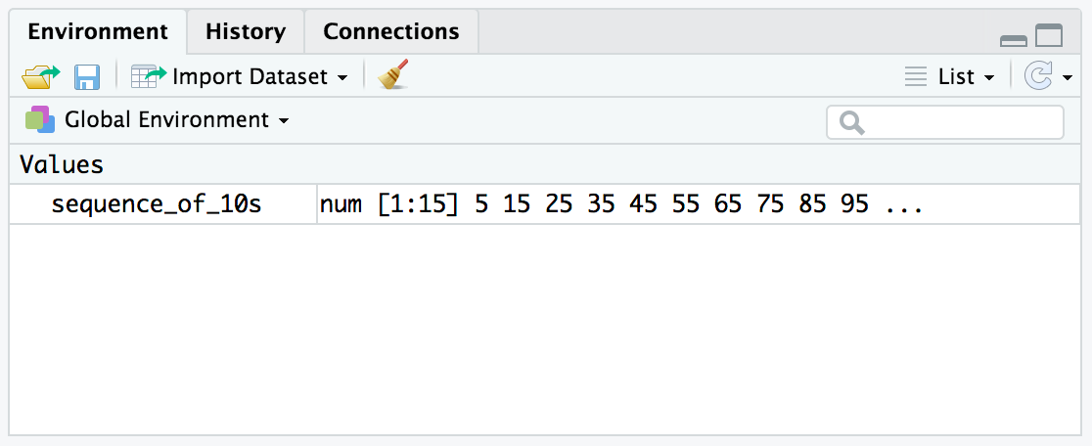
Checking the contents of an object
The environment tab shows us the objects we have created.
Notes:
We can also review our object in RStudio via the environment tab.
When we create an object in the environment, it will appear in the environment tab and we can review its contents there.

Slide 23
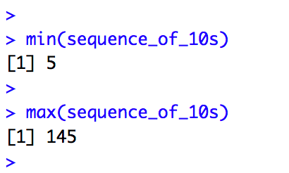
Bending objects to your will
Once we have created an object we can start to interact with it.
This includes passing our objects to other functions… Whoa!
Notes:
Objects are subject to same laws of programming we have learned so far.
We can provides objects as arguments for functions.

Slide 24
Your Turn 2
Generate a sequence, store it to an object, and ply your object
Type the following code to create a sequence from 0 to 500 in increments of 25 called sequence_of_25s:
sequence_of_25s <- seq(from=0, to=500, by=25)
Calculate the median value of this series using the median() function
Notes:
Time for another your turn.
Create your own sequence and assign it to an object with the code specified on the slide.
Can you use the median() function to find the median value in this series of integers?

Slide 25
The Basics of Coding: Packages
A package is a collection of functions.
Packages extend the capabilities of the base R programming language.
The tidyverse includes functions for reading data into the R environment, cleaning and manipulating data, and plotting our results.
Notes:
Packages are collections of functions that extend the capabilities of R. They are written and published by members of the R community.
Packages are hosted on The Comprehensive R Archive Network [CRAN] at https://cran.r-project.org/. There are are 10,000 packages in CRAN, wow!
The tidyverse is an example of a package. It includes specialized functions for reading data, cleaning, data, performing analysis, and visualizing results.
We will make extensive use of the tidyverse in today’s course and encourage you to use it in your own work.

Slide 26
Installing and Loading Packages
Installing a package
Loading into your environment
function
(does stuff)
arguments
(input)
install.packages("tidyverse")
library(tidyverse)
Notes:
To install packages we use a function called install.packages().
The principal argument for this function is the name of the package, in this example ”tidyverse”.
No need to install this package! It is pre-installed for you in RStudio Cloud. However, if you are using a desktop install of RStudio (now or in the future) you will need to install this package. Packages are installed one time per computer.
When we want to call functions from the tidyverse into our analysis, we need to load the package. We use the library() function. Packages are loaded one time per session.

Slide 27
Importing Data and Working with Dataframes (aka Useful Data)
Notes:
Vectors are useful, dataframes are even more useful and most closely represent the data we know and love!

Slide 28
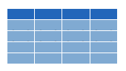


Dataframes: Beyond the Vector
Dataframe is the term for a table
Dataframes are composed:
Columns (Variables)
Rows (Observations)
Dataframes are objects and can be acted on like other objects
csv
xls
db
Notes:
Dataframe is the term we use for a table (think Excel spreadsheet).
Dataframes consists of columns (variables) and rows (observations). This is the tidy way to organize our data.
We can store dataframes as objects and perform actions on them like other objects.
We can get data into R from a variety of file formats (comma separated value files, excel spreadsheets, or directly from databases). This is the import part of data analysis.

Slide 29
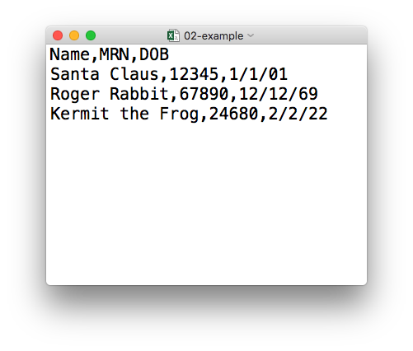
plain text (“flat”) file
rectangular structure
header row
Notes:
The data we will use for today’s course is in a file format called CSV. CSV stands for comma-separated values.
A CSV file is a plain text file, which means you can open it in a text editor and look at it.
Here we have a CSV file with the names, MRNs, and date of birth of three “patients”.
This data structure is called rectangular because it falls into rows and columns, where each row has the same # of columns, and each column has the same # of rows.
Also note that this particular CSV file has a header row that, instead of data, has a descriptor of what kinds of data are found in each column. CSV files often but not always have such a header row.

Slide 30
Loading Data to Create a Dataframe
data_frame <- read_csv(“file_name”)
csv
Notes:
You can import CSV files using the read_csv() function.
Here is a template for how to use the read_csv function to create a dataframe object from a CSV file.

Slide 31
Your Turn 3
Configure environment and load the Covid Testing CSV:
Load the tidyverse library using library(tidyverse)
Use the read_csv() function to load the data
-File_name argument: “data/covid_testing.csv”
-Object name: covid_testing
Notes:
Your turn again!
Let’s load some data from a CSV file into a dataframe called covid_testing using the read_csv() function.
Don’t forget to load the tidyverse with library() function first if you haven’t loaded it already this session.

Slide 32
read_csv()
data frame to read data into
name of
CSV file
covid_testing <- read_csv(“data/covid_testing.csv”)
covid_testing
covid_testing.csv
csv

Slide 33
What’s in a name?
Capitalization matters
Strive for names that are concise and meaningful (not easy!)
covid_testing
≠
Covid_testing
≠
COVID_TESTING
Bad
Still not great
Good
p
name
patient_name
Notes:
Developing good naming conventions pays dividends!
Best practices for naming:
meaningful
concise
consistent
lower case
underscores between words

Slide 34
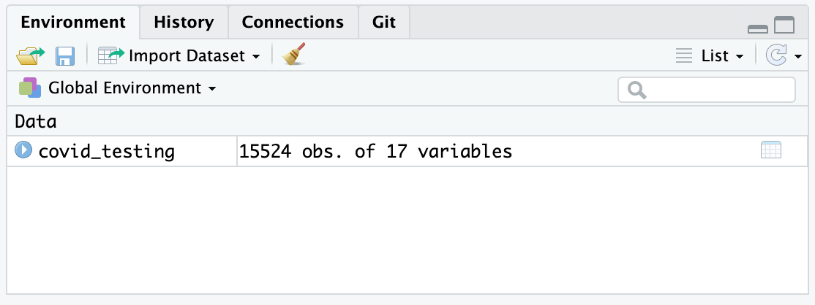
Viewing the Contents of a Dataframe
single click to explore the data
Notes:
To view the contents of an object, we can single click the name of the object in the environment tab.

Slide 35
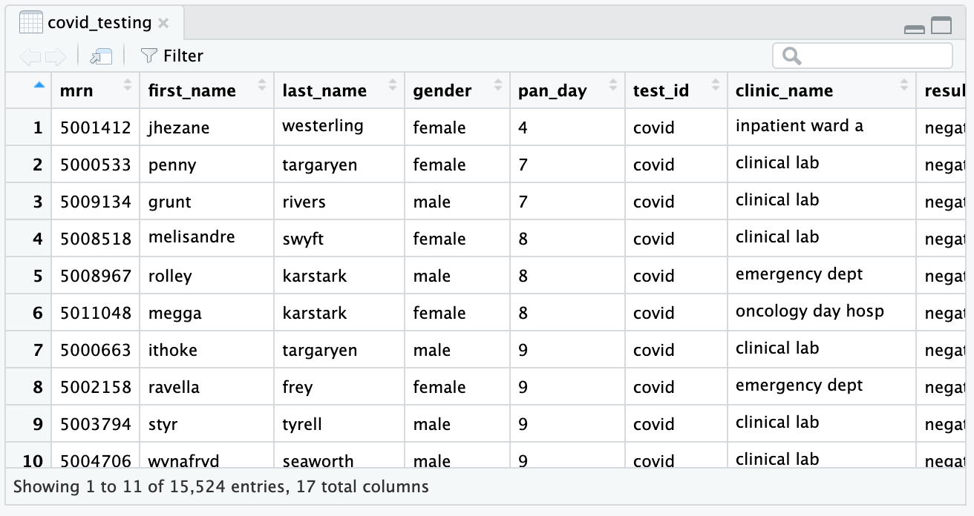
Viewing the Contents of a Dataframe
17 Attributes (Columns)
15,524 Observations (Rows)
Notes:
This data frame consists of 17 attributes (columns) and 15,524 observations (rows).
After exploring the data in the dataframe we can close it by selecting the “x” in the tab at the top left of the pane.

Slide 36
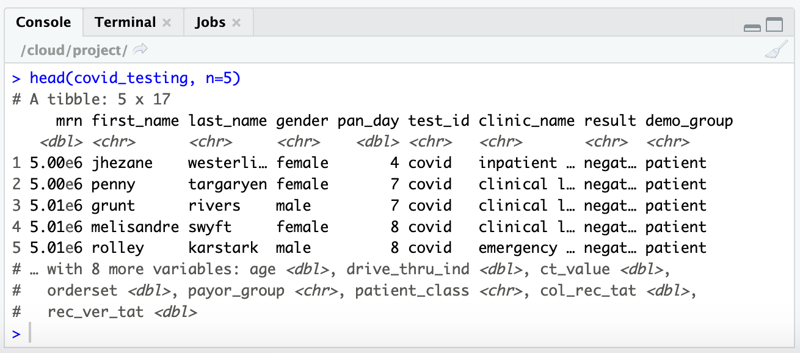
Working with Dataframes at the Console
The head() function is helpful for displaying a snippet of your dataframe
head(object_name, n=number of rows to view)
Sample of Data in Your Object
Notes:
Alternatively, you can render a quick looks at your dataframe using the head() function.
The arguments for this function are the name of the object, and the number of rows you want to view.
In this example, we requested the first 5 rows of data.

Slide 37
Your Turn 4
Understanding Object Contents
Use the tail() function to view the last 10 rows of our object covid_testing.
-What is the ratio of female to male patients in this subset of data?
Notes:
One last your turn.
Let’s use our knowledge of the head() function and apply it to the end of the table using the tail() function.

Slide 38

A Hero is Born
Hi! My name is Mark Down and I am here to save earth from non-reproducible reporting.
Notes:
It’s easy to get confused about which objects you have created and what their contents are when developing at the console. It’s also easy to accidentally overwrite the contents of an object without realizing it, further muddying the environment.
Within a couple hours of learning to program in R, you may start to get frustrated with the console.
Luckily there is a better way! And this is what we will explore in the next session.

Slide 39
Lesson Goals
Get oriented to R and RStudio
Learn some fundamentals of coding
Lesson Objectives
Log in and tour RStudio Cloud
Execute code at the console
Define and use functions
Define and create objects in the environment
Load data into R and interact with a dataframe

